Slide 1
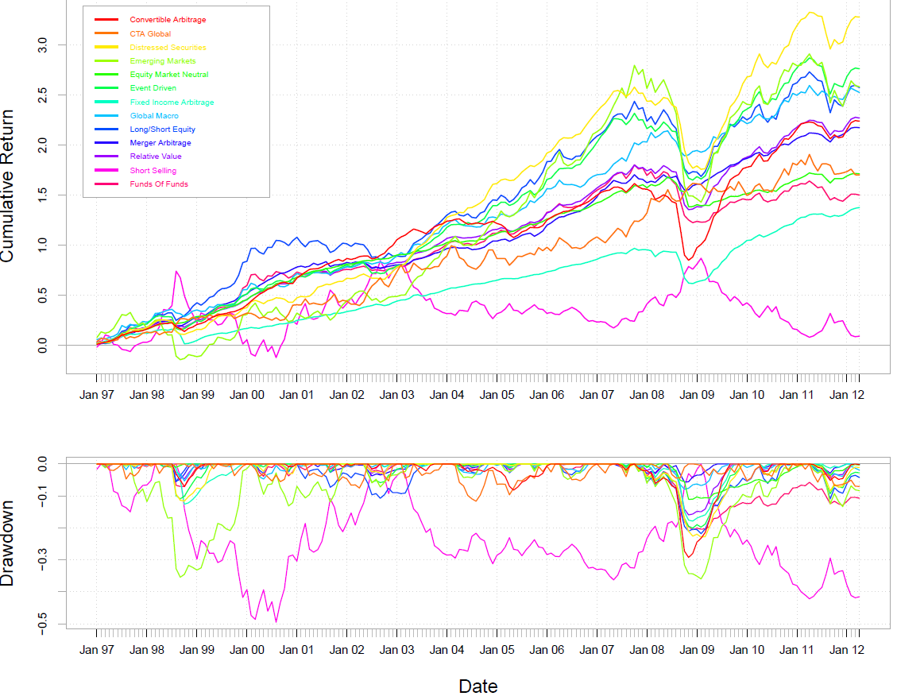
EDHEC Alternative Indexes

